Slide 1

TEAM 3
BALA NITISH AKSHAY KANTINEDI SELVARAJ
FARHAM KHADEMI
CLIVE LEWIS DEZIL MODI
MIN JUNG
DIJKSTRA’S ALGORITHM
“The question of whether computers can think is like the question of whether submarines can swim;”
-Edsger Wybe Dijkstra
Notes:
min jung

Slide 2
OVERVIEW
The project's goal is to put Dijkstra's algorithm which is a foundational technique for determining the shortest path between two vertices in a graph into practice.
In a graph with non-negative edge weights, Dijkstra's algorithm effectively determines the shortest path between a single source vertex and every other vertex.
Notes:
min jung

Slide 3
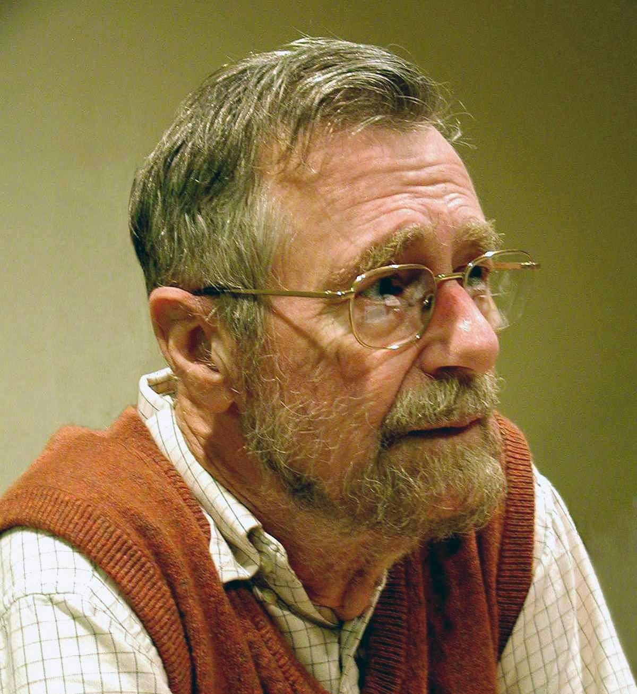
HISTORY OF DIJKSTRA’S ALGORITHM
Author: Edsger Wybe Dijkstra (1930-2002).
Worked: 1956.
Publication: Formally described in 1959 through paper “A note on two problems in connexion with graphs.”
Award: Received the A. M. Turing Award in 1972.
Works: Renowned for developing ALGOL 60 as well as for Dijkstra's Algorithm
Notes:
dezil

Slide 4
DIJKSTRA’S ALGORITHM
Dijkstra's Algorithm is a powerful tool for optimal path finding.
Finds the shortest paths from a single fixed source to all other sources in a graph.
Approach: Greedy
Components: Nodes, Edges, and Weights
Nodes: The points of intersection within a network.
Edges: The relationships between the nodes within a network.
Weights: The “cost” associated with the edge.
Limitations of Dijkstra’s Algorithm:
The graph should be weighted.
The weights should be non-negative.
A
Nodes (Vertices)
Directed Edges (Links)
3
Weights
Notes:
dezil

Slide 5
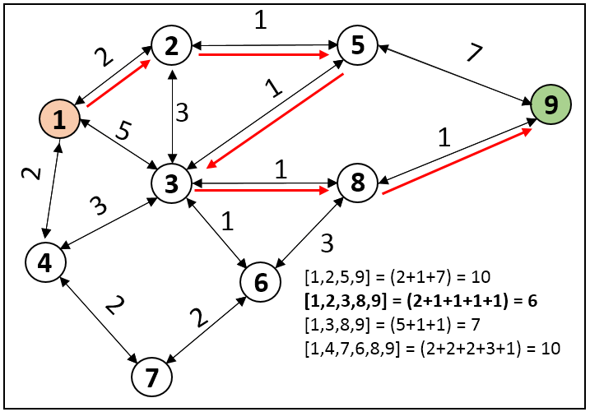
WORKING
Note: The shortest path tree identified using Dijkstra's technique will attempt to avoid edges with bigger weights because they indicate that the edge has a large weight/cost.
Notes:
farham-
Shows the critical path (Shortest Distance) to every other Node from the source node.
The way the algorithm works , It evaluates Edges of neighboring Nodes, and Visits the neighboring Nodes with the Lower Edge. While visiting the Neighboring Node it will evaluate and if current path to current node is the shortest it will update the distance of the current Node from the Source Node.
The algorithm continues this process until all Nodes have been visited in the same manner.
This process allows the Algorithm to discover the critical path to every Node while Eliminating the longest path to every node.

Slide 6
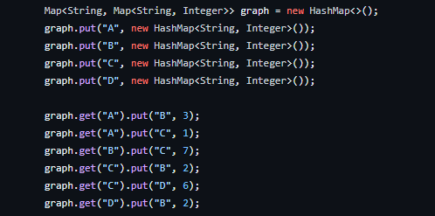
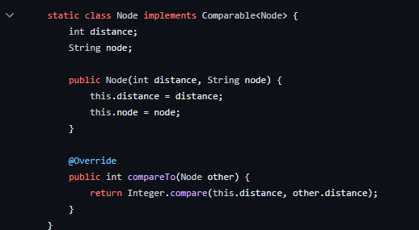

OUR IMPLEMENTATION
HashMap Approach for creating Trees
Node class utilization for storing weights to reach each node
Use of distances HashMap to track shortest distance to each node
Notes:
clive

Slide 7
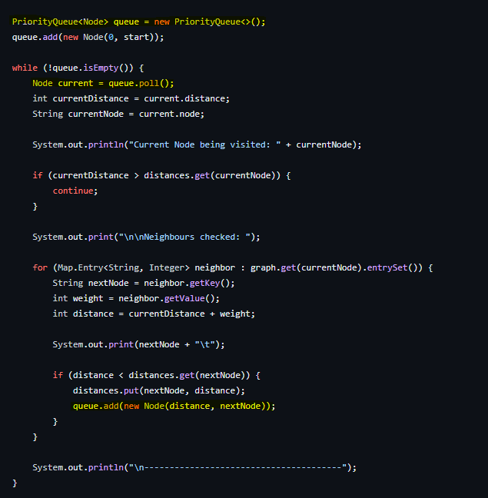
OUR IMPLEMENTATION
PriorityQueue to poll the node with the shorted weight
Notes:
clive

Slide 8
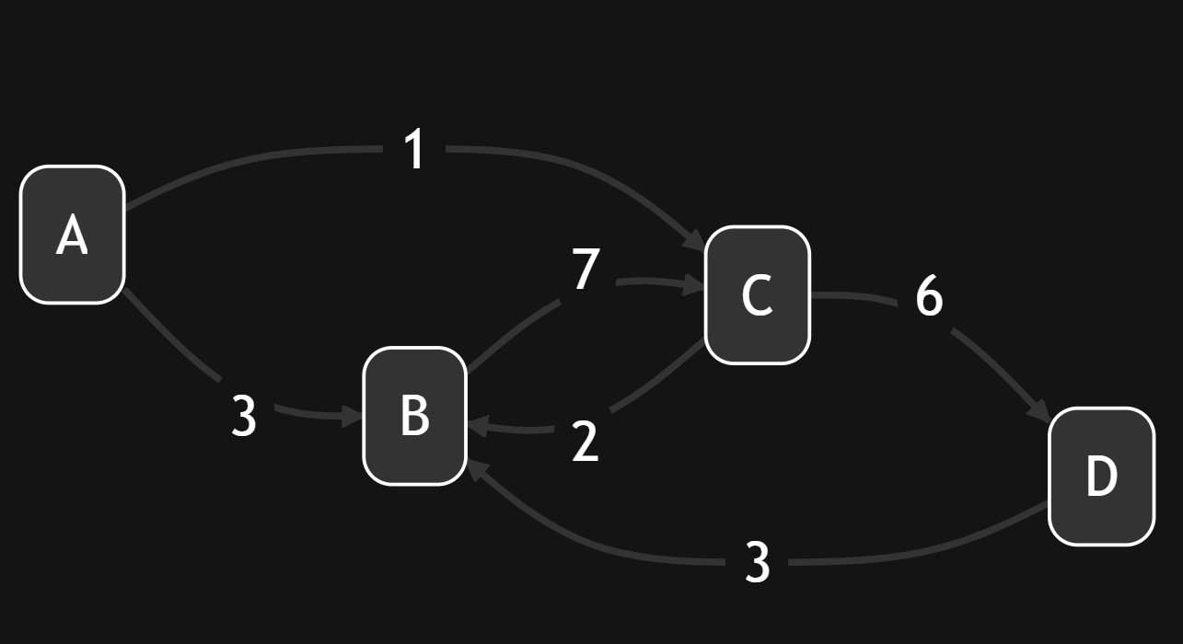
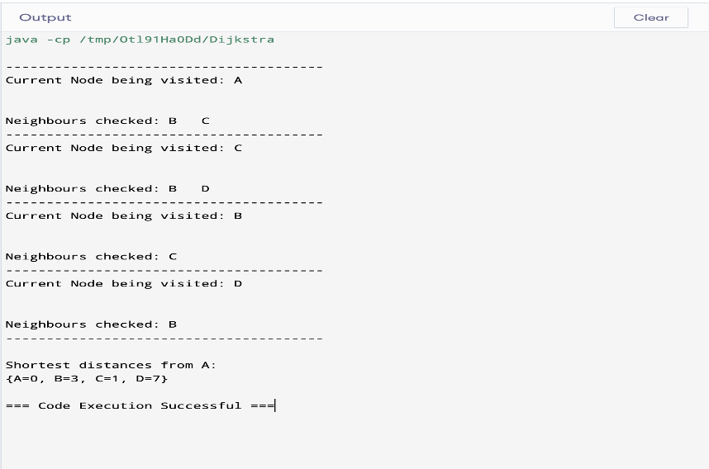
RUNTIME ANALYSIS
Graphical Representation and the Output of Our Implementation
Notes:
farham
Starting at Node A (THE SOURCE NODE)
Visiting A check B and C
Value Distance C 1 and Distance B 3 updated priority Que
Visit C lower Value - Check B and D
A to B to C → Distance is 3,
A to C to D → Distance is 7
Visit B , only direction is C:
Distance to C does not get updated due to existing lower distance from source Node
Visit D, because univisted. (Goal of the Algorithm)
Checks Neighbor B
Does Not require the update Distance to Que.
By following this logic the algorith will output shortest path to each Node from the source node.

Slide 9
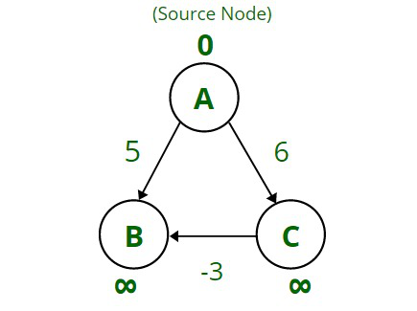
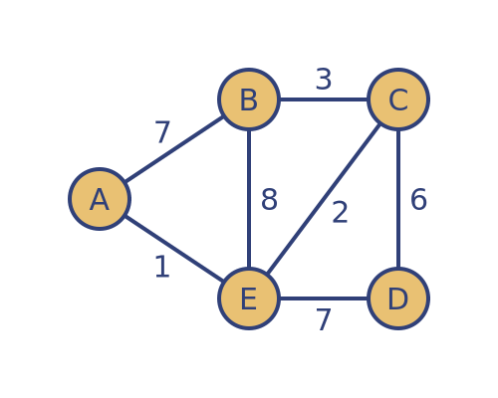
ADVANTAGE AND DISADVANTAGE OF DIJKSTRA'S ALGORITHM
Advantages:
Low Complex and Optimal
Works for both directed and undirected graphs
Linear time complexity
Good Efficiency to solve large problems
Disadvantages:
Time consuming: Takes time to conduct a blind search.
Unable to handle negative weights
Doesn’t work well on non uniformed graphs
Notes:
Nitish

Slide 10
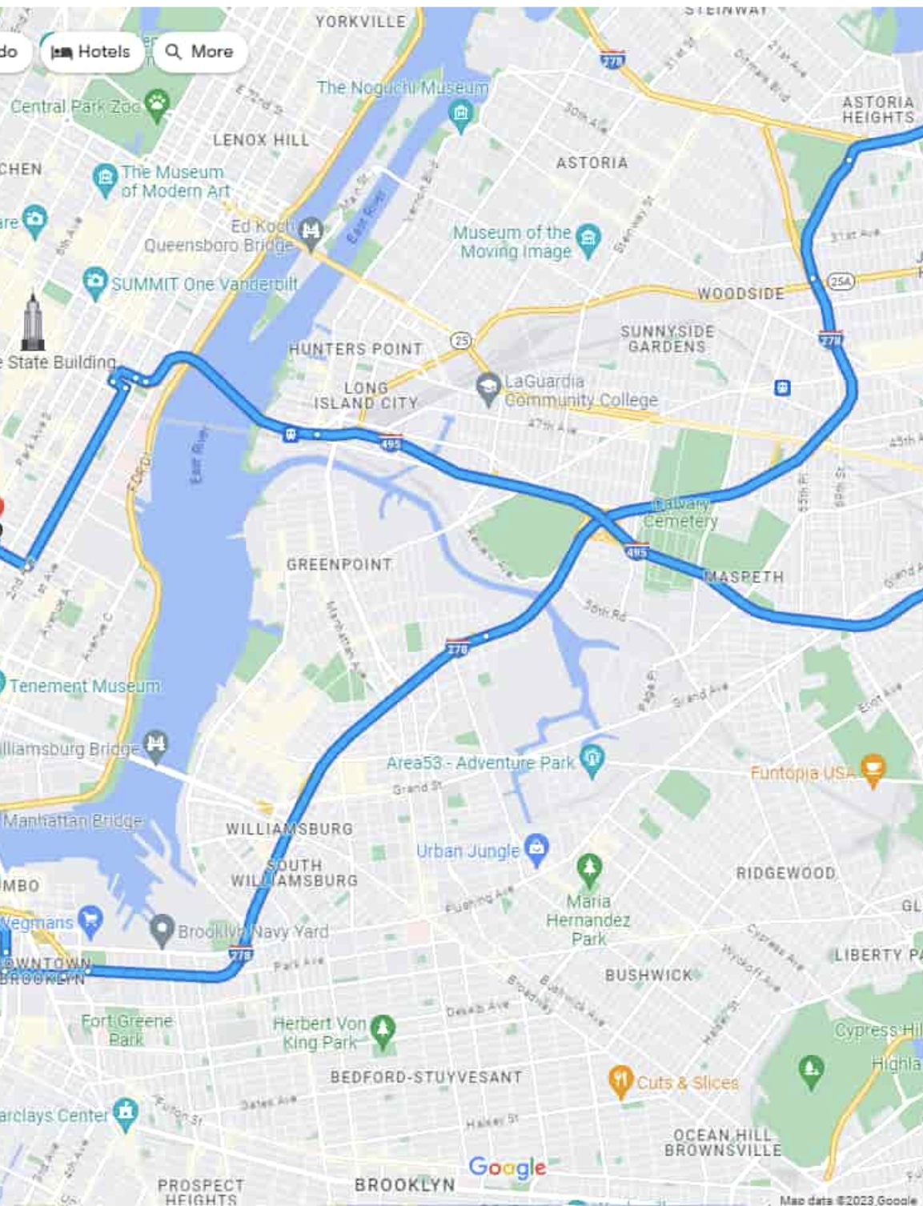
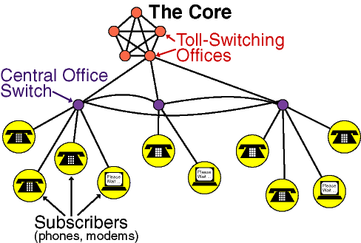
APPLICATIONS OF DIJKSTRA'S ALGORITHM
Digital Mapping (Google Maps):Used to find the shortest distance between the locations
Network System: Used to find the shortest tower for the connection of the network.
Flight Coordination Platform: Used to find the flight details for example distance, time etc.
Notes:
Nitish

Slide 11


